Slide 1
Screw Theory as a Unified Approach for Rigid, Soft Articulated and Soft Continuum Robots
June. 3rd 2019, Lille, France.
Federico Renda^{12*}
*federico.renda@ku.ac.ae
¹ Department of Mechanical Engineering, Khalifa University, Abu Dhabi, UAE.
² Khalifa University Center for Autonomous Robotic System (KU-CARS), Khalifa University, Abu Dhabi, UAE.

Slide 2
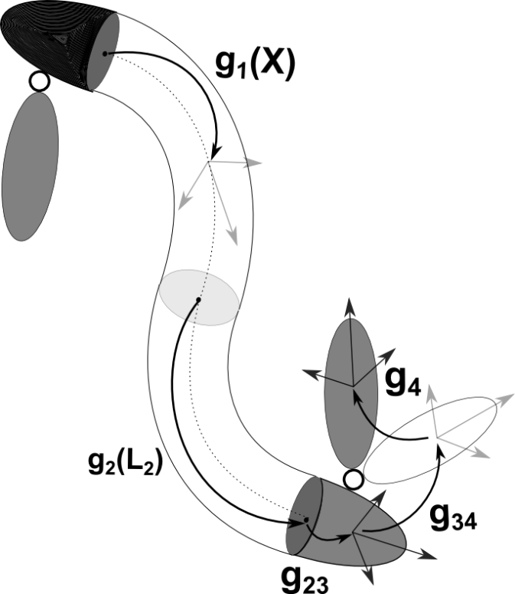
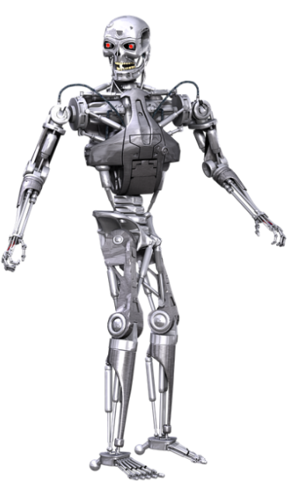

MODELLING OF SOFT-RIGID ROBOTS
DISCRETE COSSERAT APPROACH
RIGID-LINK ROBOTS
SOFT ROBOTS
Geometric approach based on the exponential map
Treats rigid, soft or hybrid robots indistinctly
Distributed Degrees of Freedom
Many different modeling approaches including constant curvature, continuous Cosserat and FEM approach
Lumped Degrees of Freedom (usually revolute angles)
Lagrangian Model
F. Renda and L. Seneviratne, "A Geometric and Unified Approach for Modeling Soft-Rigid Multi-Body Systems with Lumped and Distributed Degrees of Freedom," 2018 IEEE International Conference on Robotics and Automation (ICRA), Brisbane, Australia, 2018, pp. 1567-1574.

Slide 3
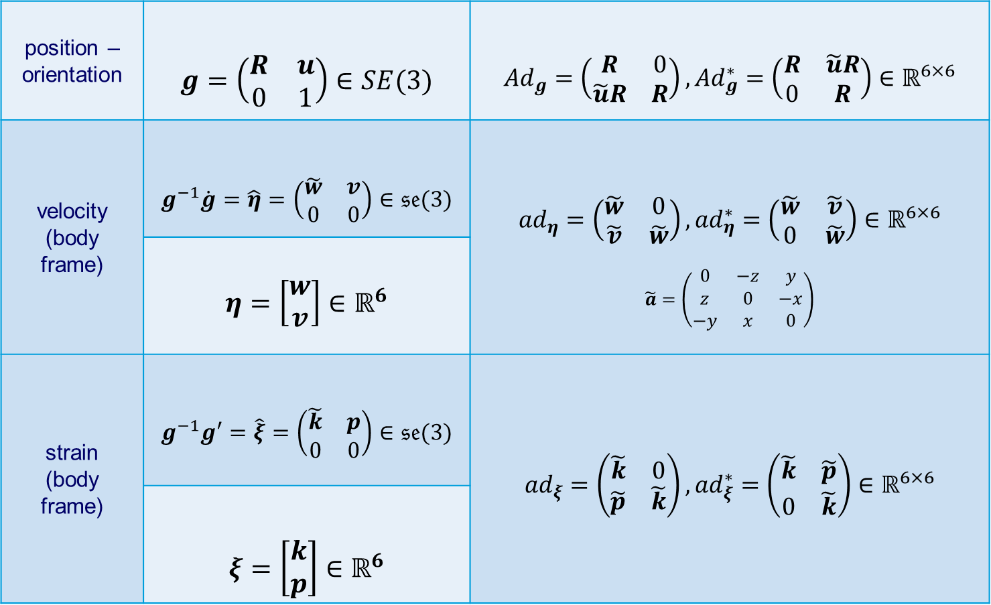
LIE GROUP NOTATIONS
position – orientation | $$g=\left(\begin{matrix}R & u \\ 0 & 1\end{matrix}\right)∈SE(3)$$ | $${Ad}_{g}=\left(\begin{matrix}R & 0 \\ \tilde{u}R & R\end{matrix}\right), {Ad}_{g}^{∗}=\left(\begin{matrix}R & \tilde{u}R \\ 0 & R\end{matrix}\right)∈ℝ^{6×6}$$
velocity (body frame) | $$g^{−1}\dot{g}=\hat{η}=\left(\begin{matrix}\tilde{w} & v \\ 0 & 0\end{matrix}\right)∈𝔰𝔢(3)$$ | $${ad}_{η}=\left(\begin{matrix}\tilde{w} & 0 \\ \tilde{v} & \tilde{w}\end{matrix}\right), {ad}_{η}^{∗}=\left(\begin{matrix}\tilde{w} & \tilde{v} \\ 0 & \tilde{w}\end{matrix}\right)∈ℝ^{6×6}$$ $$\tilde{a}=\left(\begin{matrix}0 & −z & y \\ z & 0 & −x \\ −y & x & 0\end{matrix}\right)$$
 | $$η=\left[\begin{matrix}w \\ v\end{matrix}\right]∈ℝ^{6}$$
strain (body frame) | $$g^{−1}g′=\hat{ξ}=\left(\begin{matrix}\tilde{k} & p \\ 0 & 0\end{matrix}\right)∈𝔰𝔢(3)$$ | $${ad}_{ξ}=\left(\begin{matrix}\tilde{k} & 0 \\ \tilde{p} & \tilde{k}\end{matrix}\right), {ad}_{ξ}^{∗}=\left(\begin{matrix}\tilde{k} & \tilde{p} \\ 0 & \tilde{k}\end{matrix}\right)∈ℝ^{6×6}$$
 | $$ξ=\left[\begin{matrix}k \\ p\end{matrix}\right]∈ℝ^{6}$$
standard representation
Adjoint and coAdjoint representation
Lie Algebra element
adjoint and coadjoint map
twist vector
Where
Lie Algebra element
adjoint and coadjoint map
twist vector
J. M. Selig. Geometric Fundamentals of Robotics. Monographs in Computer Science. Springer New York, 2007.

Slide 4
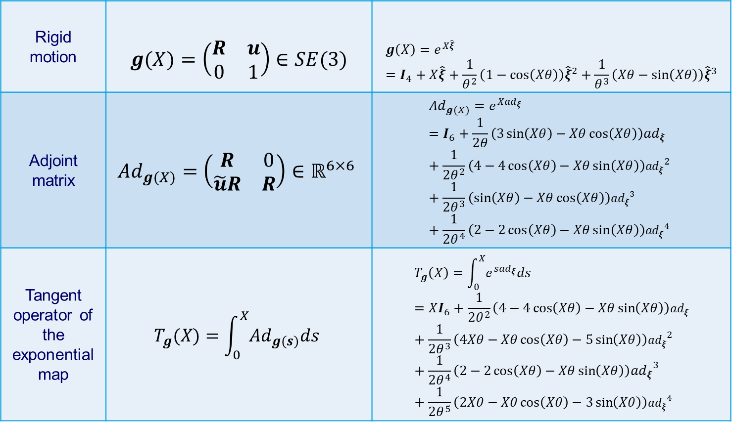
EXPONENTIAL FUNCTIONS
Rigid motion | $$g(X)=\left(\begin{matrix}R & u \\ 0 & 1\end{matrix}\right)∈SE(3)$$ | $$g\left(X\right)=e^{X\hat{ξ}}=I_{4}+X\hat{ξ}+\frac{1}{θ^{2}}\left(1−\cos\left(Xθ\right)\right){\hat{ξ}}^{2}+\frac{1}{θ^{3}}\left(Xθ−\sin\left(Xθ\right)\right){\hat{ξ}}^{3}$$
Adjoint matrix | $${Ad}_{g(X)}=\left(\begin{matrix}R & 0 \\ \tilde{u}R & R\end{matrix}\right)∈ℝ^{6×6}$$ | $${Ad}_{g(X)}=e^{X{ad}_{ξ}}=I_{6}+\frac{1}{2θ}\left(3\sin\left(Xθ\right)−Xθ\cos\left(Xθ\right)\right){ad}_{ξ}+\frac{1}{2θ^{2}}\left(4−4\cos\left(Xθ\right)−Xθ\sin\left(Xθ\right)\right){{ad}_{ξ}}^{2}+\frac{1}{2θ^{3}}\left(\sin\left(Xθ\right)−Xθ\cos\left(Xθ\right)\right){{ad}_{ξ}}^{3}+\frac{1}{2θ^{4}}\left(2−2\cos\left(Xθ\right)−Xθ\sin\left(Xθ\right)\right){{ad}_{ξ}}^{4}$$
Tangent operator of the exponential map | $$T_{g}(X)=\int_{0}^{X}{{Ad}_{g(s)}ds}$$ | $$T_{g}\left(X\right)=\int_{0}^{X}{e^{s{ad}_{ξ}}ds}=XI_{6}+\frac{1}{2θ^{2}}\left(4−4\cos\left(Xθ\right)−Xθ\sin\left(Xθ\right)\right){ad}_{ξ}+\frac{1}{2θ^{3}}\left(4Xθ−Xθ\cos\left(Xθ\right)−5\sin\left(Xθ\right)\right){{ad}_{ξ}}^{2}+\frac{1}{2θ^{4}}\left(2−2\cos\left(Xθ\right)−Xθ\sin\left(Xθ\right)\right){{ad}_{ξ}}^{3}+\frac{1}{2θ^{5}}\left(2Xθ−Xθ\cos\left(Xθ\right)−3\sin\left(Xθ\right)\right){{ad}_{ξ}}^{4}$$
standard representation
exponential representation
J. M. Selig. Geometric Fundamentals of Robotics. Monographs in Computer Science. Springer New York, 2007.

Slide 5
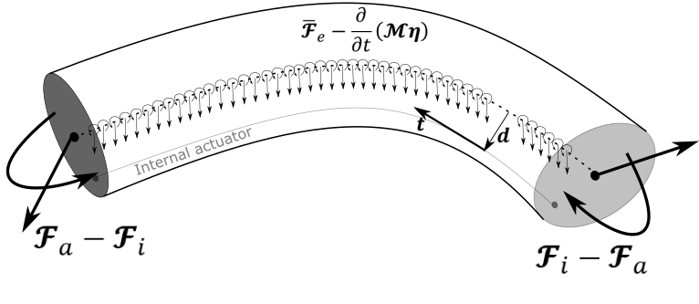
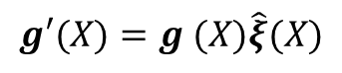
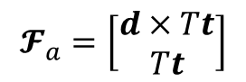
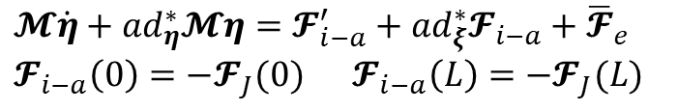
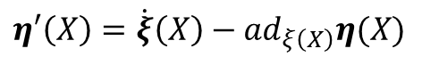
CONTINUOUS COSSERAT ROD
Taking the equilibrium of a continuous section of an elastic rod and limiting the length of the section to zero, we obtain the PDE describing the rod dynamics
KINEMATICS
The space derivative of the roto-translation gives the strain
$$g′(X)=g (X)\hat{ξ}(X)$$
DIFFERENTIAL KINEMATICS
Equality of mixed partial derivative of g
$$η′\left(X\right)=\dot{ξ}\left(X\right)−{ad}_{ξ\left(X\right)}η(X)$$
INTERNAL ACTUATION
COSSERAT ROD DYNAMICS
PDE describing a Cosserat Rod in local frame
The internal actuation is given by the equilibrium of the actuator internal force
$$𝓜\dot{η}+{ad}_{η}^{∗}𝓜η=𝓕_{i−a}^{′}+{ad}_{ξ}^{∗}𝓕_{i−a}+{\overline{𝓕}}_{e} \\ 𝓕_{i−a}\left(0\right)=−𝓕_{J}(0) 𝓕_{i−a}\left(L\right)=−𝓕_{J}(L)$$
$$𝓕_{a}=\left[\begin{matrix}d×Tt \\ Tt\end{matrix}\right]$$
F. Renda, F. Boyer, J. Dias and L. Seneviratne. Discrete Cosserat Approach for Multi-Section Soft Manipulators Dynamics. Robotics, IEEE Transactions on, vol. 34, no. 6, pp. 1518-1533, Dec. 2018..

Slide 6
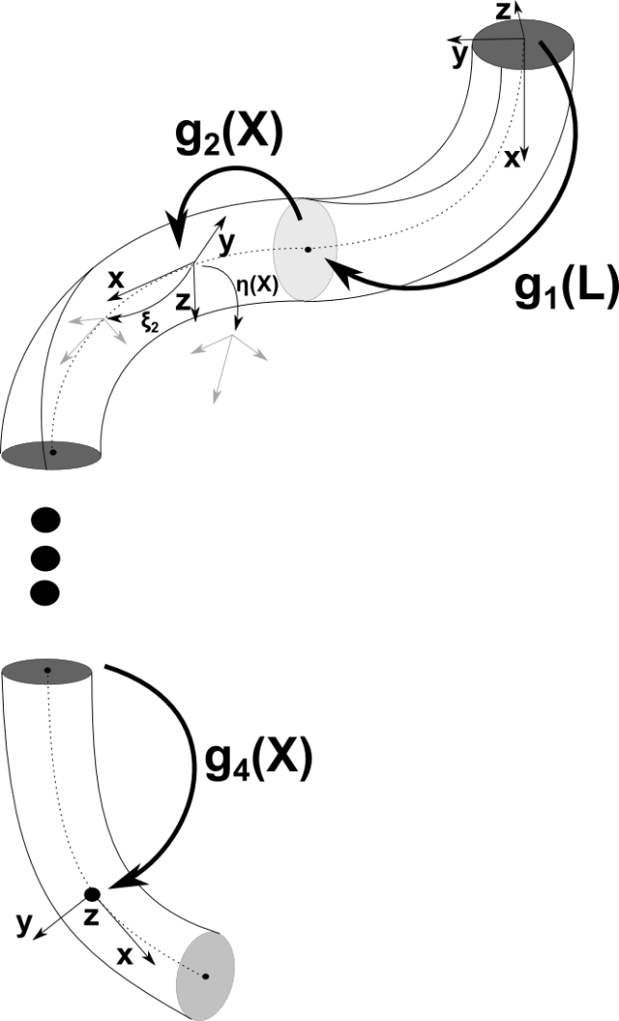
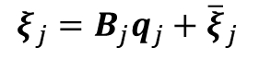
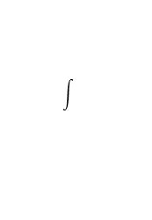
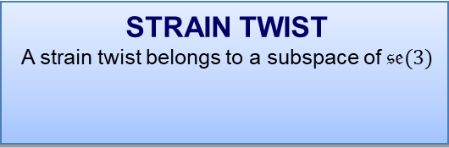
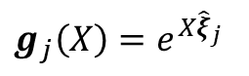
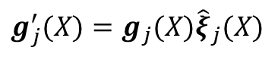
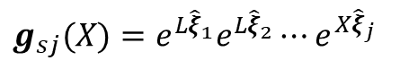
FROM CONTINUUM TO DISCRETE COSSERAT the Constant Strain Approach
Kinematics
The robot arm is divided in N pieces of constant strain
We move from a continuous strain field $ξ(X)$ to piecewise constant field $ξ_{1},..ξ_{N}$
KINEMATICS
Continuous strain field
EXPONENTIAL MAP
constant strain field
$$g_{j}^{′}(X)=g_{j}(X){\hat{ξ}}_{j}(X)$$
$$g_{j}\left(X\right)=e^{X{\hat{ξ}}_{j}}$$
STRAIN TWIST
A strain twist belongs to a subspace of $𝔰𝔢(3)$
$$ξ_{j}=B_{j}q_{j}+{\overline{ξ}}_{j}$$
POE FORMULA
Twist are expressed in the body frame
$$g_{sj}(X)=e^{L{\hat{ξ}}_{1}}e^{{L\hat{ξ}}_{2}}⋯e^{X{\hat{ξ}}_{j}}$$
F. Renda, F. Boyer, J. Dias and L. Seneviratne. Discrete Cosserat Approach for Multi-Section Soft Manipulators Dynamics. Robotics, IEEE Transactions on, vol. 34, no. 6, pp. 1518-1533, Dec. 2018..

Slide 7
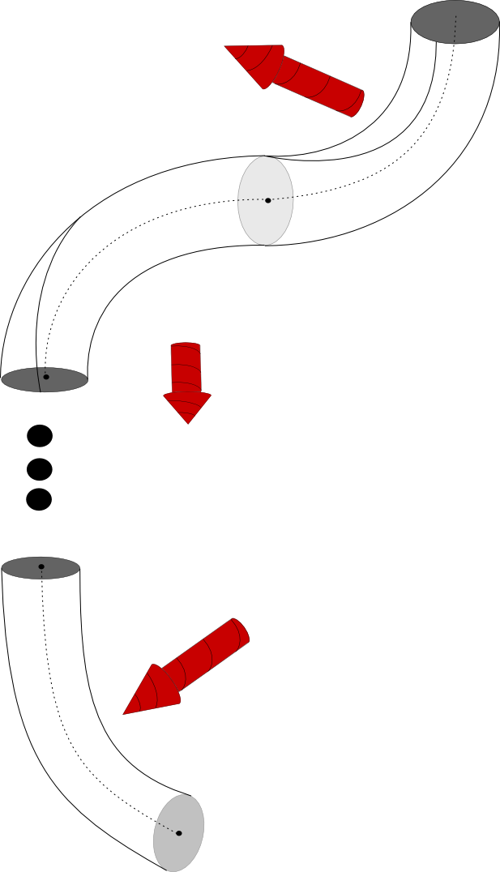
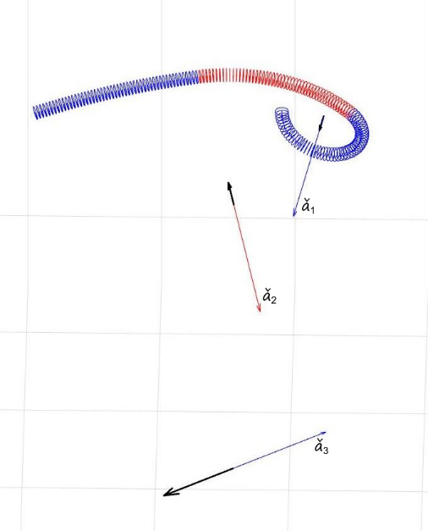
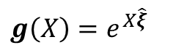
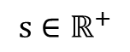
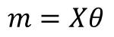
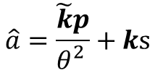
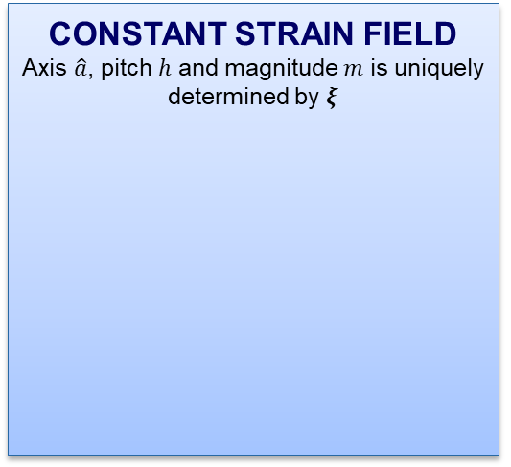
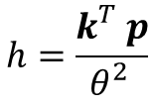
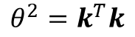
GEOMETRIC INTERPRETATION
Screw-based Geometry
Each section is an arc of screw, constant curvature circular arc is a special case
SCREW MOTION
$$g\left(X\right)=e^{X\hat{ξ}}$$
CONSTANT STRAIN FIELD
Axis $\hat{a}$, pitch $h$ and magnitude $m$ is uniquely determined by 𝝃
$$h=\frac{k_{}^{T}p}{θ_{}^{2}}$$
$$\hat{a}=\frac{\tilde{k}p}{θ_{}^{2}}+ks$$
$$m=Xθ$$
Where
$$θ^{2}=k^{T}k$$
and
$$s∈ℝ^{+}$$
F. Renda, M. Cianchetti, H. Abidi, J. Dias and L. Seneviratne. Screw-Based Modeling of Soft Manipulators with Tendon and Fluidic Actuation. ASME Journal of Mechanism and Robotics, 9(4):041012-041012-8, 2017.

Slide 8
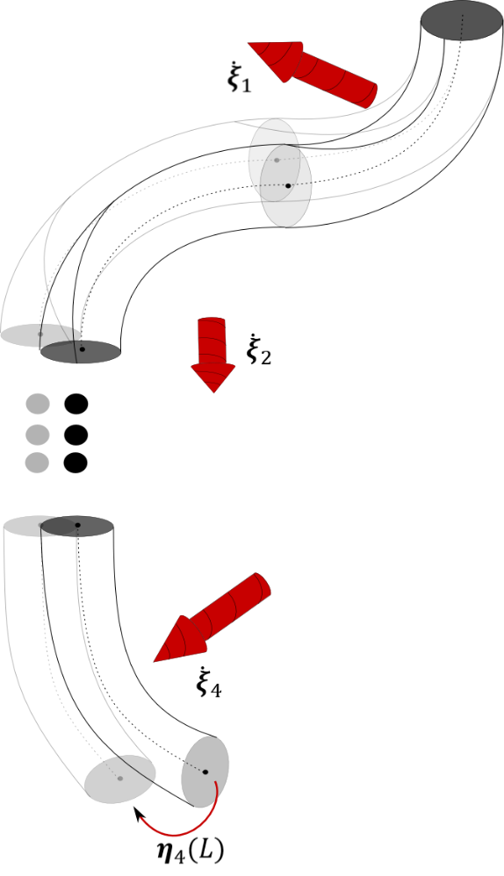
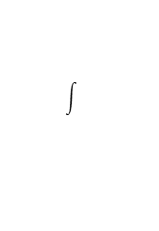
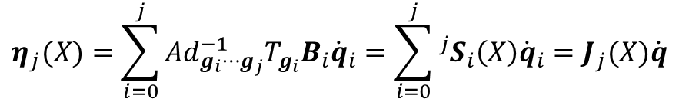
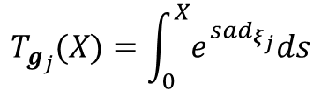
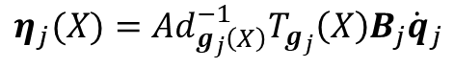
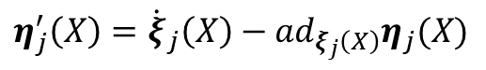
FROM CONTINUUM TO DISCRETE COSSERAT the Constant Strain Approach
Differential Kinematics
Under the constant strain assumption, we can analytically integrate the velocity-strain relation, which yields to a soft robotics geometric Jacobian
DIFFERENTIAL KINEMATICS
continuous strain field
DIFFERENTIAL MAP
constant strain field
$$η_{j}^{′}\left(X\right)={\dot{ξ}}_{j}\left(X\right)−{ad}_{ξ_{j}\left(X\right)}η_{j}(X)$$
$$η_{j}(X)={Ad}_{g_{j}\left(X\right)}^{−1}T_{g_{j}}\left(X\right)B_{j}{\dot{q}}_{j}$$
TANGENT OPERATOR OF THE EXPONENTIAL MAP
From time derivative of strain twist to velocity twist
$$T_{g_{j}}(X)=\int_{0}^{X}{e^{s{ad}_{ξ_{j}}}ds}$$
GEOMETRIC JACOBIAN
Soft robotics geometric Jacobian
$$η_{j}(X)=\sum_{i=0}^{j}{{Ad}_{g_{i}⋯g_{j}}^{−1}T_{g_{i}}B_{i}{\dot{q}}_{i}}=\sum_{i=0}^{j}{{}_{ }^{j}{S_{i}\left(X\right)}{\dot{q}}_{i}}=J_{j}(X)\dot{q}$$
F. Renda, F. Boyer, J. Dias and L. Seneviratne. Discrete Cosserat Approach for Multi-Section Soft Manipulators Dynamics. Robotics, IEEE Transactions on, vol. 34, no. 6, pp. 1518-1533, Dec. 2018..

Slide 9
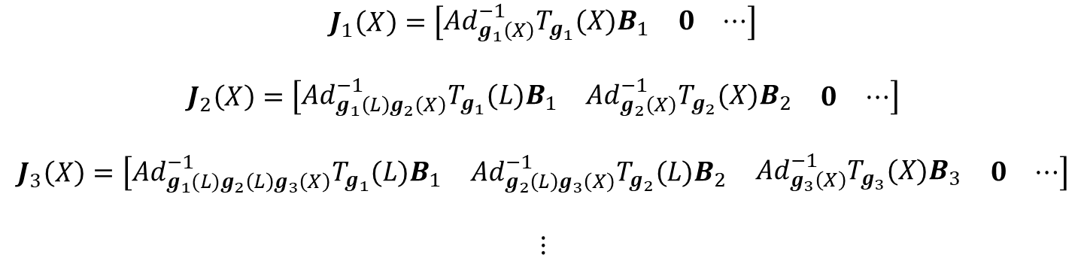
FROM CONTINUUM TO DISCRETE COSSERAT the Constant Strain Approach
Differential Kinematics
Under the constant strain assumption, we can analytically integrate the velocity-strain relation, which yields to a soft robotics geometric Jacobian
GEOMETRIC JACOBIAN
Soft robotics geometric Jacobian
$$J_{1}\left(X\right)=\left[\begin{matrix}{Ad}_{g_{1}\left(X\right)}^{−1}T_{g_{1}}(X)B_{1} & 0 & ⋯\end{matrix}\right]$$
$$J_{2}\left(X\right)=\left[\begin{matrix}{Ad}_{g_{1}\left(L\right)g_{2}\left(X\right)}^{−1}T_{g_{1}}(L)B_{1} & {Ad}_{g_{2}\left(X\right)}^{−1}T_{g_{2}}(X)B_{2} & \begin{matrix}0 & ⋯\end{matrix}\end{matrix}\right]$$
$$J_{3}\left(X\right)=\left[\begin{matrix}{Ad}_{g_{1}(L)g_{2}\left(L\right)g_{3}\left(X\right)}^{−1}T_{g_{1}}(L)B_{1} & {Ad}_{g_{2}\left(L\right)g_{3}\left(X\right)}^{−1}T_{g_{2}}(L)B_{2} & \begin{matrix}{Ad}_{g_{3}\left(X\right)}^{−1}T_{g_{3}}(X)B_{3} & \begin{matrix}0 & ⋯\end{matrix}\end{matrix}\end{matrix}\right]$$
$$⋮$$
F. Renda, F. Boyer, J. Dias and L. Seneviratne. Discrete Cosserat Approach for Multi-Section Soft Manipulators Dynamics. Robotics, IEEE Transactions on, vol. 34, no. 6, pp. 1518-1533, Dec. 2018..

Slide 10
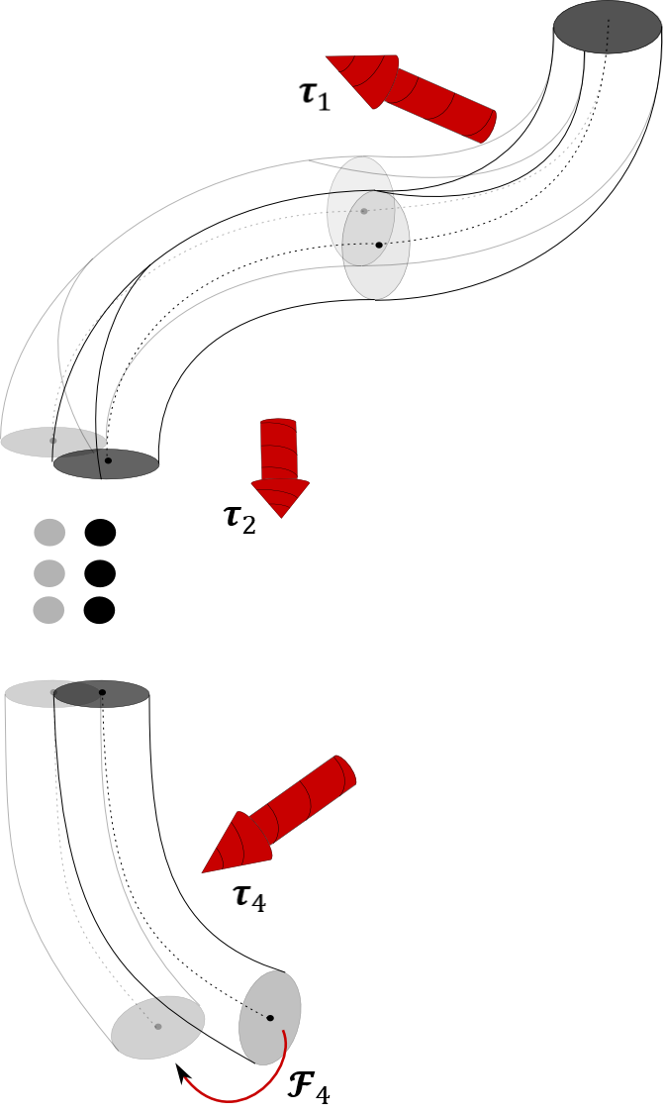
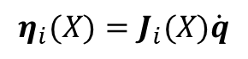
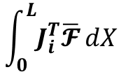
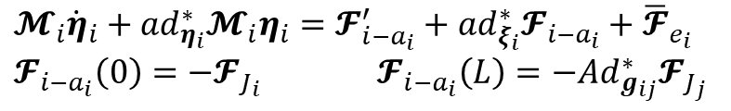
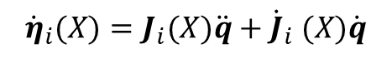
FROM CONTINUUM TO DISCRETE COSSERAT the Constant Strain Approach
Dynamics
We obtain the generalized dynamics equations for a single soft body i by projecting the Cosserat rod dynamics onto the constrained motion space
COSSERAT ROD DYNAMICS
PDE describing a Cosserat Rod in local frame
$$𝓜_{i}{\dot{η}}_{i}+{ad}_{η_{i}}^{∗}𝓜_{i}η_{i}=𝓕_{{i−a}_{i}}^{′}+{ad}_{ξ_{i}}^{∗}𝓕_{{i−a}_{i}}+{\overline{𝓕}}_{e_{i}} \\ 𝓕_{{i−a}_{i}}\left(0\right)=−𝓕_{J_{i}} 𝓕_{{i−a}_{i}}\left(L\right)=−{Ad}_{g_{ij}}^{∗}𝓕_{J_{j}}$$
PROJECTION
Projection onto the constrained motion subspace
KINEMATICS
Constrained kinematics
$$\int_{0}^{L}{J_{i}^{T}\overline{𝓕}}dX$$
$$η_{i}(X)=J_{i}(X)\dot{q}$$
$${\dot{η}}_{i}(X)=J_{i}(X)\ddot{q}+{\dot{J}}_{i} (X)\dot{q}$$
F. Renda, F. Boyer, J. Dias and L. Seneviratne. Discrete Cosserat Approach for Multi-Section Soft Manipulators Dynamics. Robotics, IEEE Transactions on, vol. 34, no. 6, pp. 1518-1533, Dec. 2018.

Slide 11
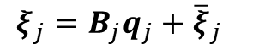
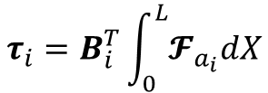
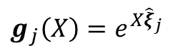
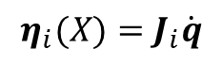
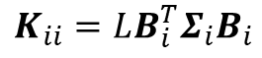
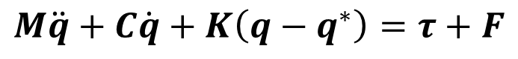
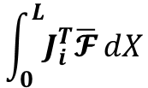
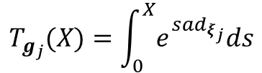
MODELLING OF SOFT-RIGID ROBOTS
DISCRETE COSSERAT APPROACH (Piece-wise constant strains)
RIGID-LINK ROBOTS
SOFT ROBOTS
EXP MAP
STRAIN TWIST
$$g_{j}\left(X\right)=e^{X{\hat{ξ}}_{j}}$$
$$ξ_{j}=B_{j}q_{j}+{\overline{ξ}}_{j}$$
TANGENT OPERATOR OF THE EXPONENTIAL MAP
$$T_{g_{j}}(X)=\int_{0}^{X}{e^{s{ad}_{ξ_{j}}}ds}$$
PROJECTION
KINEMATICS
$$\int_{0}^{L}{J_{i}^{T}\overline{𝓕}}dX$$
$$η_{i}(X)=J_{i}\dot{q}$$
COSSERAT ROD DYNAMICS
$$M\ddot{q}+C\dot{q}+K\left(q−q^{∗}\right)=τ+F$$
$$τ_{i}=B_{i}^{T}\int_{0}^{L}{𝓕_{a_{i}}dX}$$
$$K_{ii}=LB_{i}^{T}Σ_{i}B_{i}$$
F. Renda and L. Seneviratne, "A Geometric and Unified Approach for Modeling Soft-Rigid Multi-Body Systems with Lumped and Distributed Degrees of Freedom," 2018 IEEE International Conference on Robotics and Automation (ICRA), Brisbane, Australia, 2018, pp. 1567-1574.

Slide 12
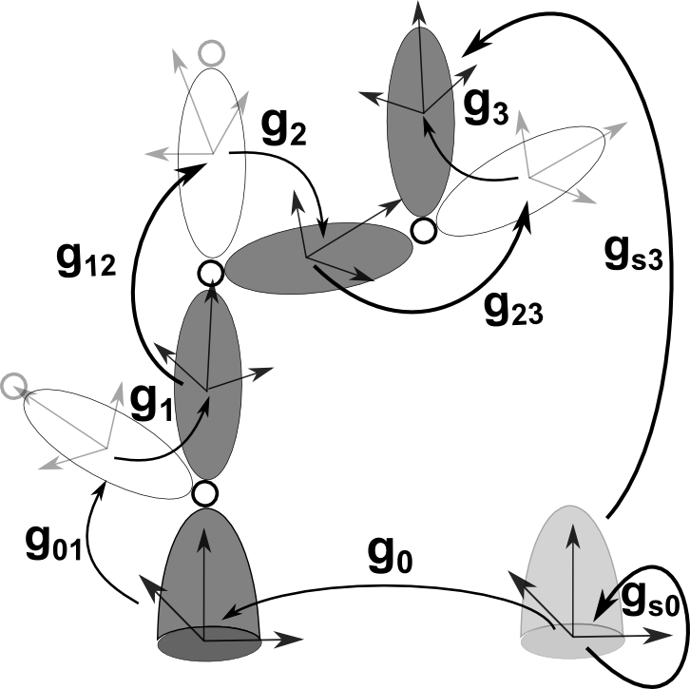
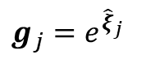
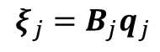
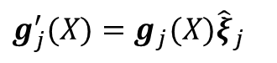
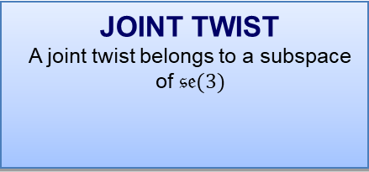

BROCKETT’S PRODUCT OF EXPONENTIALS FORMULA
KINEMATICS
Screw motion parametrized as a space trajectory with constant strain
EXPONENTIAL MAP
We follow the trajectory up to X=1
$$g_{j}^{′}(X)=g_{j}(X){\hat{ξ}}_{j}$$
$$g_{j}=e^{{\hat{ξ}}_{j}}$$
JOINT TWIST
A joint twist belongs to a subspace of $𝔰𝔢(3)$
$$ξ_{j}=B_{j}q_{j}$$
POE FORMULA
Twist are expressed in the body frame
$$g_{sj}=g_{s0}e^{{\hat{ξ}}_{0}}g_{01}e^{{\hat{ξ}}_{1}}⋯g_{ij}e^{{\hat{ξ}}_{j}}$$
Thanks to the exponential map the configuration of a multi-body system can be represented by a product of exponentials
R. W. Brockett. Robotic manipulators and the product of exponentials formula. In Mathematical Theory of Networks and Systems, pages 120–129. Springer Berlin Heidelberg, 1984.
R.M. Murray, Z. Li, and S.S. Sastry. A Mathematical Introduction to Robotic Manipulation. Taylor & Francis, 1994.

Slide 13





RIGID-LINK ROBOTS GEOMETRIC JACOBIAN
Thanks to the tangent operator of the exponential map a geometric Jacobian between joint space and Euclidean space is obtained
DIFFERENTIAL KINEMATICS
Equality of mixed partial derivative of g
DIFFERENTIAL MAP
We follow the trajectory up to X=1
$$η_{j}^{′}\left(X\right)={\dot{ξ}}_{j}−{ad}_{ξ_{j}}η_{j}(X)$$
$$η_{j}={Ad}_{g_{j}}^{−1}T_{g_{j}}B_{j}{\dot{q}}_{j}$$
TANGENT OPERATOR OF THE EXPONENTIAL MAP
From time derivative of joint twist to velocity twist
$$T_{g_{j}}=\int_{0}^{1}{e^{s{ad}_{ξ_{j}}}ds}$$
GEOMETRIC JACOBIAN
Including multi-dimensional joints
$$η_{j}=\sum_{i=0}^{j}{{Ad}_{g_{i}⋯g_{j}}^{−1}T_{g_{i}}B_{i}{\dot{q}}_{i}}=\sum_{i=0}^{j}{{}_{ }^{j}{S_{i}}{\dot{q}}_{i}}=J_{j}\dot{q}$$

Slide 14




RIGID-LINK ROBOT DYNAMICS
We obtain the generalized dynamics equations for a single body i by projecting the N-E dynamics onto the constrained motion space
NEWTON-EULER EQUATION
N-E equation for body I
$$𝓜_{i}{\dot{η}}_{i}+{ad}_{η_{i}}^{∗}𝓜_{i}η_{i}=𝓕_{J_{i}}−{Ad}_{g_{ij}g_{j}}^{∗}𝓕_{J_{j}}+𝓕_{e_{i}}$$
PROJECTION
Projection onto the constrained motion subspace
KINEMATICS
Constrained kinematics
$$η_{i}=J_{i}\dot{q}$$
$$J_{i}^{T}𝓕$$
$${\dot{η}}_{i}=J_{i}\ddot{q}+{\dot{J}}_{i}\dot{q}$$
R. Featherstone. Rigid Body Dynamics Algorithms. Springer US, 2008.

Slide 15







MODELLING OF SOFT-RIGID ROBOTS
DISCRETE COSSERAT APPROACH (Piece-wise constant strains)
RIGID-LINK ROBOTS
SOFT ROBOTS
EXP MAP
JOINT TWIST
EXP MAP
STRAIN TWIST
$$g_{i}=e^{{\hat{ξ}}_{i}}$$
$$ξ_{i}=B_{i}q_{i}$$
$$g_{j}\left(X\right)=e^{X{\hat{ξ}}_{j}}$$
$$ξ_{j}=B_{j}q_{j}+{\overline{ξ}}_{j}$$
TANGENT OPERATOR OF THE EXPONENTIAL MAP
TANGENT OPERATOR OF THE EXPONENTIAL MAP
$$T_{g_{i}}=\int_{0}^{1}{e^{s{ad}_{ξ_{i}}}ds}$$
$$T_{g_{j}}(X)=\int_{0}^{X}{e^{s{ad}_{ξ_{j}}}ds}$$
PROJECTION
KINEMATICS
PROJECTION
KINEMATICS
$$J_{i}^{T}𝓕$$
$$η_{i}=J_{i}\dot{q}$$
$$\int_{0}^{L}{J_{i}^{T}\overline{𝓕}}dX$$
$$η_{i}(X)=J_{i}\dot{q}$$
NEWTON-EULER EQUATION
COSSERAT ROD DYNAMICS
$$M\ddot{q}+C\dot{q}+K\left(q−q^{∗}\right)=τ+F$$
$$τ_{i}=B_{i}^{T}\int_{0}^{L}{𝓕_{a_{i}}dX}$$
$$K_{ii}=LB_{i}^{T}Σ_{i}B_{i}$$
$$τ_{i}={}_{ }^{i}{S_{i}^{T}𝓕_{J_{i}}}$$
$$K_{ii}={}_{ }^{i}{S_{i}^{T}}Σ_{i}B_{i}$$
F. Renda and L. Seneviratne, "A Geometric and Unified Approach for Modeling Soft-Rigid Multi-Body Systems with Lumped and Distributed Degrees of Freedom," 2018 IEEE International Conference on Robotics and Automation (ICRA), Brisbane, Australia, 2018, pp. 1567-1574.

Slide 16
EXTENDED JOINT KINEMATICS TABLE FOR SOFT-RIGID ROBOTS
F. Renda and L. Seneviratne, "A Geometric and Unified Approach for Modeling Soft-Rigid Multi-Body Systems with Lumped and Distributed Degrees of Freedom," 2018 IEEE International Conference on Robotics and Automation (ICRA), Brisbane, Australia, 2018, pp. 1567-1574.

Slide 17




ILLUSTRATIVE EXAMPLE: LOPHOTRICUS
Let’s take a motile bacteria as illustrative example
REVOLUTE JOINT
INEXTENSIBLE CONSTANT CURVATURE
KIRCHHOFF-LOVE
$$ξ_{1}=\left[\begin{matrix}\begin{matrix}1 \\ 0 \\ 0\end{matrix} \\ \begin{matrix}0 \\ 0 \\ 0\end{matrix}\end{matrix}\right]q_{1}$$
$$ξ_{3}=\left[\begin{matrix}\begin{matrix}\begin{matrix}\begin{matrix}1 \\ 0 \\ 0\end{matrix} \\ \begin{matrix}0 \\ 0 \\ 0\end{matrix}\end{matrix} & \begin{matrix}\begin{matrix}0 \\ 1 \\ 0\end{matrix} \\ \begin{matrix}0 \\ 0 \\ 0\end{matrix}\end{matrix}\end{matrix} & \begin{matrix}\begin{matrix}\begin{matrix}0 \\ 0 \\ 1\end{matrix} \\ \begin{matrix}0 \\ 0 \\ 0\end{matrix}\end{matrix} & \begin{matrix}\begin{matrix}0 \\ 0 \\ 0\end{matrix} \\ \begin{matrix}1 \\ 0 \\ 0\end{matrix}\end{matrix}\end{matrix}\end{matrix}\right]q_{3}$$
$$ξ_{2}=\left[\begin{matrix}\begin{matrix}0 \\ 1 \\ 0\end{matrix} & \begin{matrix}0 \\ 0 \\ 1\end{matrix} \\ \begin{matrix}0 \\ 0 \\ 0\end{matrix} & \begin{matrix}0 \\ 0 \\ 0\end{matrix}\end{matrix}\right]q_{2}+\left[\begin{matrix}\begin{matrix}0 \\ 0 \\ 0\end{matrix} \\ \begin{matrix}1 \\ 0 \\ 0\end{matrix}\end{matrix}\right]$$
F. A. Samatey, H. Matsunami, K. Imada, S. Nagashima, T. R. Shaikh, D. R. Thomas, J. Z. Chen, D. J. Derosier, A. Kitao and K. Namba. Structure of the bacterial flagellar hook and implication for the molecular universal joint mechanism. Nature, 431(7012):1062–1068, 2004.

Slide 18



ILLUSTRATIVE EXAMPLE: LOPHOTRICUS STRAIGHT MOTION
F. Renda and L. Seneviratne, "A Geometric and Unified Approach for Modeling Soft-Rigid Multi-Body Systems with Lumped and Distributed Degrees of Freedom," 2018 IEEE International Conference on Robotics and Automation (ICRA), Brisbane, Australia, 2018, pp. 1567-1574.

Slide 19



ILLUSTRATIVE EXAMPLE: LOPHOTRICUS SINK MOTION
F. Renda and L. Seneviratne, "A Geometric and Unified Approach for Modeling Soft-Rigid Multi-Body Systems with Lumped and Distributed Degrees of Freedom," 2018 IEEE International Conference on Robotics and Automation (ICRA), Brisbane, Australia, 2018, pp. 1567-1574.

Slide 20




SELF-PROPULSION RESULTS (I)
Soft Flagellum (Dragon Skin 30)
Rigid Flagellum (ABS)
UNPUBLISHED

Slide 21




OCTOPUS ARM MANIPULATOR
The model has been applied to a cable driven octopus-like manipulator
The friction between the cables and the silicone body is not considered
PARALLEL CABLES ACTUATION
SIMO-REISSNER
$$ξ_{1}=q_{1}$$
Three sections and four cables for section
$$τ_{1}=L𝓕_{a_{1}}$$
F. Renda, M. Giorelli, M. Calisti, M. Cianchetti and C. Laschi "Dynamic Model of a Multibending Soft Robot Arm Driven by Cables" Robotics, IEEE Transactions on , vol.30, no.5, pp.1109,1122, Oct. 2014.

Slide 22

OCTOPUS ARM EXPERIMENTAL RESULTS
F. Renda, F. Boyer, J. Dias and L. Seneviratne. Discrete Cosserat Approach for Multi-Section Soft Manipulators Dynamics. Robotics, IEEE Transactions on, vol. 34, no. 6, pp. 1518-1533, Dec. 2018.

Slide 23






STIFF-FLOP MANIPULATOR
The model has been used to solve the inverse statics of the Stiff-Flop medical manipulator
PARALLEL FLUIDIC ACTUATION
INVERSE KINEMATICS
$$τ_{1}=L𝓕_{a_{1}}$$
$$ξ_{1}={\log\left(g_{1}(L)\right)}/L$$
SIMO-REISSNER
STATICS
$$ξ_{1}=q_{1}$$
$$0=τ−K\left(q−q^{∗}\right)+F$$
F. Renda, M. Cianchetti, H. Abidi, J. Dias and L. Seneviratne. Screw-Based Modeling of Soft Manipulators with Tendon and Fluidic Actuation. ASME Journal of Mechanism and Robotics, 9(4):041012-041012-8, 2017.

Slide 24







RECURSIVE NEWTON-EULER ALGHORITHM the floating-base inverse dynamics problem
The recursive N-E algorithms for floating-base multi-body dynamics can be extended to hybrid (soft-rigid) systems
FIRST PASS: KINEMATICS
Recursive calculation of the relative (to the base) kinematics quantities
SECOND STEP: DYN. SUM
Summation of all the dynamics equations expressed in the base frame
THIRD PASS: TORQUES
Recursive calculation of the actuation forces/torques
$$η_{j}(X)={Ad}_{g_{ij}g_{j}}^{−1}η_{i}+{}_{ }^{j}{S_{j}{\dot{q}}_{j}}$$
PROJECTION
$$0=\sum_{i}{\left({}_{ }^{0}{𝓜_{i}^{t}}\right)}{\dot{η}}_{0}+ \\ \sum_{i}{\left(\int_{0}^{L}{{}_{ }^{0}{𝓜_{i}^{ }{}_{ }^{0}{{\dot{η}}_{i}^{r}}dX}}+{}_{ }^{0}{𝓟_{i}^{t}}\right)}$$
$$\int_{0}^{L}{{}_{ }^{i}{S_{i}^{T}}\overline{𝓕}}dX$$
$${\dot{η}}_{j}^{r}\left(X\right)={Ad}_{g_{ij}g_{j}}^{−1}{\dot{η}}_{i}^{r}+{}_{ }^{j}{S_{j}{\ddot{q}}_{j}} \\ +{ad}_{{Ad}_{g_{ij}g_{j}}^{−1}η_{i}}{}_{ }^{j}{S_{j}{\dot{q}}_{j}}$$
COSSERAT ROD DYNAMICS
F. Renda and L. Seneviratne, "A Geometric and Unified Approach for Modeling Soft-Rigid Multi-Body Systems with Lumped and Distributed Degrees of Freedom," 2018 IEEE International Conference on Robotics and Automation (ICRA), Brisbane, Australia, 2018, pp. 1567-1574.
R. Featherstone. Rigid Body Dynamics Algorithms. Springer US, 2008.

Slide 25





RECURSIVE NEWTON-EULER ALGHORITHM the floating-base forward dynamics problem
FIRST PASS: KINEMATICS
Recursive calculation of the kinematics quantities
SECOND PASS: ART. BODY
Recursive calculation of the articulated body inertia and force
THIRD PASS: ACCEL.
Recursive calculation of the bodies’ acceleration
PROJECTION
$$η_{j}(X)={Ad}_{g_{ij}g_{j}}^{−1}η_{i}+{}_{ }^{j}{S_{j}{\dot{q}}_{j}}$$
ART. BODY EQ.
$$\int_{0}^{L}{{}_{ }^{i}{S_{i}^{T}}\overline{𝓕}}dX$$
$$𝓕_{J_{j}}=𝓜_{j}^{A}{\dot{η}}_{j}+𝓟_{j}^{A}$$
PROJECTION
COSSERAT ROD DYNAMICS
$$\int_{0}^{L}{{}_{ }^{i}{S_{i}^{T}}\overline{𝓕}}dX$$
$${\dot{η}}_{j}\left(X\right)={Ad}_{g_{ij}g_{j}}^{−1}{\dot{η}}_{i}+{}_{ }^{j}{S_{j}{\ddot{q}}_{j}} \\ +{ad}_{{Ad}_{g_{ij}g_{j}}^{−1}η_{i}}{}_{ }^{j}{S_{j}{\dot{q}}_{j}}$$
COSSERAT ROD DYNAMICS
F. Renda and L. Seneviratne, "A Geometric and Unified Approach for Modeling Soft-Rigid Multi-Body Systems with Lumped and Distributed Degrees of Freedom," 2018 IEEE International Conference on Robotics and Automation (ICRA), Brisbane, Australia, 2018, pp. 1567-1574.
R. Featherstone. Rigid Body Dynamics Algorithms. Springer US, 2008.

Slide 26






COMPLIANT GRIPPER
Manipulator’s ellipsoids can be calculated to optimize the gripping performance
EXTERNAL CABLE ACTUATION
INEX. CONST. TORSION AND BENDING
$$τ_{3}={}_{ }^{3}{S_{3}^{T}}𝓕_{T_{3}}$$
$$ξ_{3}=\left[\begin{matrix}\begin{matrix}1 \\ 0 \\ 0\end{matrix} & \begin{matrix}0 \\ 0 \\ 1\end{matrix} \\ \begin{matrix}0 \\ 0 \\ 0\end{matrix} & \begin{matrix}0 \\ 0 \\ 0\end{matrix}\end{matrix}\right]q_{3}+\left[\begin{matrix}\begin{matrix}0 \\ 0 \\ 0\end{matrix} \\ \begin{matrix}1 \\ 0 \\ 0\end{matrix}\end{matrix}\right]$$
MANIPULABILITY ELLIPSOID
STIFFNESS ELLIPSOID
$${\left(J_{w}J_{w}^{T}\right)}^{−1}$$
$${\left(J_{w}K^{−1}J_{w}^{T}\right)}^{2}$$
I. Hussain et al., "Modeling and Prototyping of an Underactuated Gripper Exploiting Joint Compliance and Modularity," in IEEE Robotics and Automation Letters, vol. 3, no. 4, pp. 2854-2861, Oct. 2018.

Slide 27


CLOSED-CHAIN COMPLIANT GRIPPER (I)
Adopting the technique developed for closed-chain multi-body systems, the model can be used for closed-chain soft-rigid manipulators like the FinRay finger
PFAFFIAN CONSTRAIN
The closed-chain joints restrict the motion space of the corresponding open-chain system
$$\left[\begin{matrix}\begin{matrix}B_{h}^{⊥T}\left(J_{p_{h}}−J_{s_{h}}\right) \\ B_{k}^{⊥T}\left(J_{p_{k}}−J_{s_{k}}\right)\end{matrix} \\ \begin{matrix}⋮ \\ B_{l}^{⊥T}\left(J_{p_{l}}−J_{s_{l}}\right)\end{matrix}\end{matrix}\right]\dot{q}=A\left(q\right)\dot{q}=0$$
Muddasar Anwar, Toufik Al Khawli, Irfan Hussain, Dongming Gan, Federico Renda, (2019) "Modeling and prototyping of a soft closed-chain modular gripper", Industrial Robot: the international journal of robotics research and application, Vol. 46 Issue: 1, pp.135-145

Slide 28



CLOSED-CHAIN COMPLIANT GRIPPER (II)
CLOSED-CHAIN DYNAMIC EQUATION
The open-chain dynamics is augmented with the constrain forces of the (passive) closed-chain joints
$$\left\{\begin{aligned}M\ddot{q}+C\dot{q}+K\left(q−q^{∗}\right)=τ+F+A^{T}λ \\ A\ddot{q}+\dot{A}\dot{q}=0\end{aligned}\right.⇒ \\ M\ddot{q}+C\dot{q}+K\left(q−q^{∗}\right)=Pτ+F+A^{T}{\left(AM^{−1}A^{T}\right)}^{−1}\left[AM^{−1}\left(C\dot{q}−F\right)−\dot{A}\dot{q}\right]$$
Where $P=I−A^{T}{\left(AM^{−1}A^{T}\right)}^{−1}AM^{−1}$ projects away joint wrenches that act on the constraints without doing any work on the system
Dynamics
Statics
Irfan Hussain, Muddasar Anwar, Dongming Gan, Federico Renda, "Modeling, Analysis and Prototyping of Closed Chain Fingers Inspired by Fin Ray Effect.", Robotics, IEEE Transactions on, 2019 (in preparation).

Slide 29
CONCLUSION
A discrete Cosserat approach (piece-wise constant strain) is used to build a geometric and unified modeling framework for rigid, soft or hybrid (soft-rigid) robots
The model is in fact a generalization to soft and hybrid systems of the geometric theory of rigid robotics, characterized by the exponential map
Benefits
Limitations
No restrictions on the form of the internal strain energy
Good generality inherited by the Cosserat rod theory
Suitable for control purpose
Unique framework to transduce traditional robotics results to the soft robotics practice
Cross-section deformations are kinematically not allowed
Only one dimensional media are considered
No off-the-shelf software available

Slide 30

THANK YOU!
federico.renda@ku.ac.ae

